Slide 1
Basic Navigation
IN721 2019
Design and Development for Mobile Devices
Session 4.1
Notes:
To see all of your app’s content and functionality, the user must be able to navigate
Often, this is from Activity to Activity
Sometimes the user actually stays at the same Activity, and just the content changes.
Either way, it is essential that the user knows where he is, where he can go to, and how to get back to where he came from.
That’s what navigation is about
Today we will start by noting the various types of navigation
Then we will look at two simple but effective techniques for implementing them.
Android actually provides a few more ways, that are very useful in some circumstances, but we will have to learn a few more things about the framework (specifically, how to work with fragments) before we can use those.

Slide 2
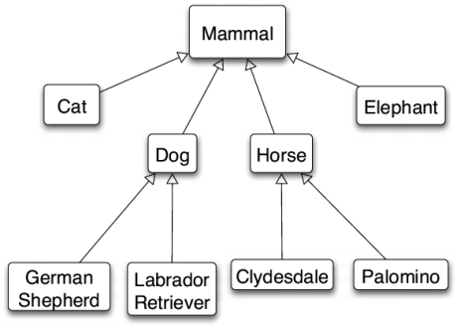
Information Organisation
Hierarchical
Notes:
Critical to the usability of your app is the organisation of information
“Information architecture” describes the relationships between the various elements in your system.
The most common is hierarchical.
Here is a familiar hierarchical system.
Categories broken down into subcategories broken down into examples.

Slide 3
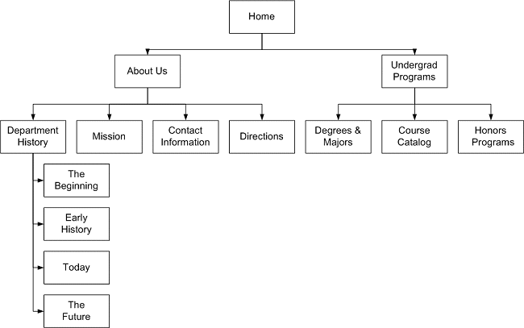
Information Organisation
Hierarchical
Notes:
Here’s how hierarchical structures often appear in software navigation.
Here’s an example that shows the structure of information about a typical college (from Rutgers.edu).
Main topics are broken down into sub sections
Subsections can be further broken down into other subsections, or into collections of related items
Since this is the most common architecture, we will concentrate on it, but the principles can be easily extended to others. For example, stars or rings.
When discussing these sorts of structures we often use the familial metaphor: parent, child, siblings, etc.
The individual elements are called “nodes”
Nodes with no children are leaves
The single node at the top is the root.
Someone using your app is effectively wandering around in the organisational structure you provide.
It is essential that they can move easily around the tree.

Slide 4
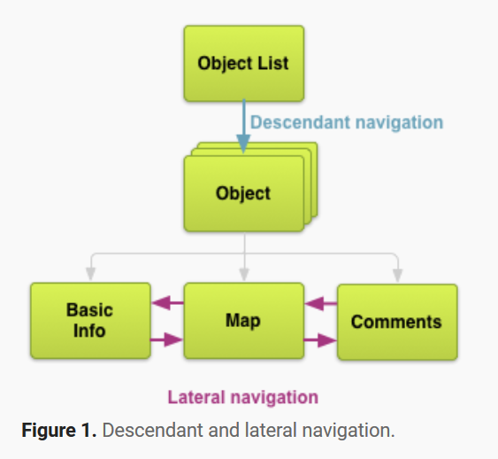
Hierarchical Navigation
Vertical or Horizontal
Notes:
For hierarchical systems, we have two main types of navigation: Vertical and Horizontal
Down the tree, or across siblings
Android calls these “Descendant” and “Lateral”, as shown in this schematic of some general sort of app

Slide 5
Hierarchical Navigation
Vertical
Parent to child
Child to parent (up)
Any node to root (home)
Horizontal
Sections (usually few)
Collections (may be many)
Notes:
Within the two main types, we can break things down like this
We are going to look at how to build this kind of navigation in Android.
For simplicity, we are going to concentrate on navigating between separate activities (that is, we are going to pretend that every node in the tree is its own Activity).
In actual practice, we might not call an intent, we might just change the contents of the current activity (for example, change the ImageUrl of an image view).
To the user this is transparent – they navigate the same.
Further, in our examples the Activities are not going to do anything – they’ll just display some identifying content.
But again, the principles of getting to the Activity are unaffected by what the Activity does.

Slide 6

Example
Westminster Kennel Club Breed Information App
Notes:
This is big business.
The kennel clubs want to make this information available so people will buy dogs, and so forth.
Here are some pictures (for no particular reason, except that I like dog pictures...)

Slide 7

Westminster

Slide 8

Westminster

Slide 9

Westminster

Slide 10

Westminster
Notes:
Anyway....

Slide 11
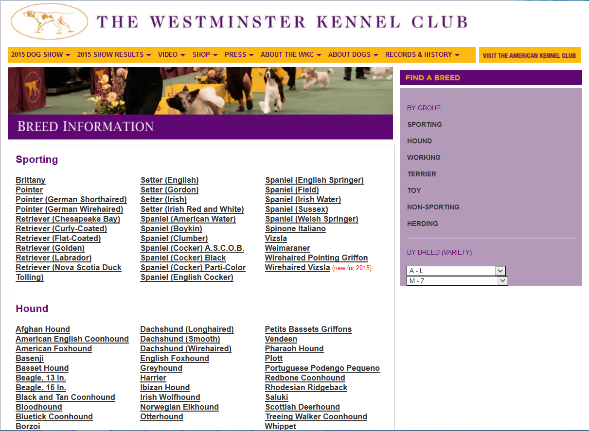
First Architecture
Westminster Kennel Club Breed Information App
Notes:
From their website
Here is how the breed information works. There are 7 groups, and each group has between about 20 to 40 breeds in it.
The architecture can be shown schematically like this...

Slide 12
Information Architecture
Main
Sub 1
Sub 2
Sub n
...
Notes:
The ellipsis and “sub n” mean “assume there are n branches here”
This is the simplest hierarchical architecture.
For the actual dog breed thing, we can think of it as..

Slide 13
Information Architecture
Breed Groups
Sporting
Hound
Herding
...
Notes:
Our plan for this architecture is to make a main screen with a nav control to each child.
Each child screen then shows its data (which is, in this case, the list of dog breeds in the group).
We make one Activity for the main nav and one for each child (think: can you see where we might find some efficiencies?)
You could already build this app, actually. On your main activity, place a button for each group. Wire the button up to launch an intent to the corresponding Activity.
Then on each Breed Group sub page, provide some way to get back (depending on the hard back button is not good enough...)
It might be good practice, in fact, to do this.
There is however, a better way in Android. Specifically, there is a better control to use: the ListView.
ListView is what it sounds like: a list.
Its advantages over buttons are:
No alignment hassles
You only have to write one handler for the whole control (as opposed to seven handlers for seven buttons)
It scrolls (so you can actually have more nav items that can fit on the screen).
Here’s what the app will look like...

Slide 14
Navigation Option 1
Use ListView for the main screen navigation

Slide 15
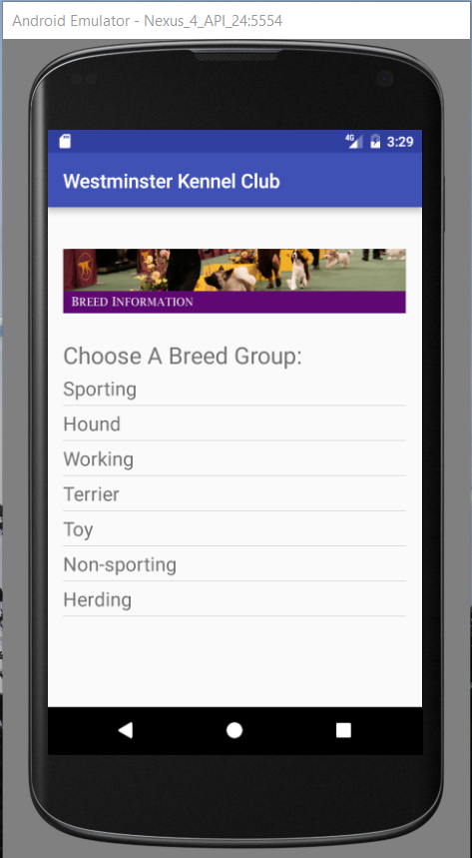
Screenshots
Notes:
The launch activity.
This is a single ListView control, not a bunch of separate TextViews.
(If you had to guess, how do you think you get the contents into that ListView...? => Adapter)
Each of these is clickable. This is built-in to the ListView control
Onclick, they highlight. This is automatic with ListView.
If we choose, say, the Working group...

Slide 16
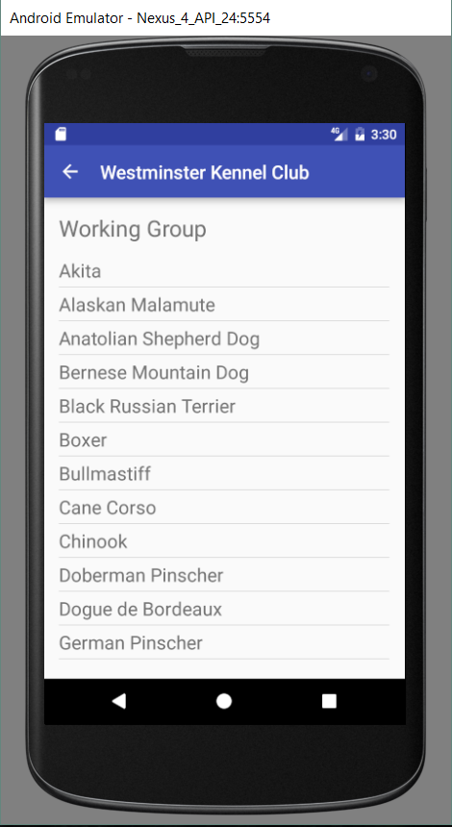
Screenshots
Notes:
We see this.
These could be links to individual screens about each breed. (For practice, you might want to try to implement that.)
Note the little up/back control.
Android does this for us if we set up our activities correctly. We will see how in a minute.
Thus, if you use this architecture, you don’t have to implement your own historical navigation at all.
Each link from the main takes us to the corresponding group
If we go back...

Slide 17
Screenshots
Notes:
and choose Herding group...

Slide 18
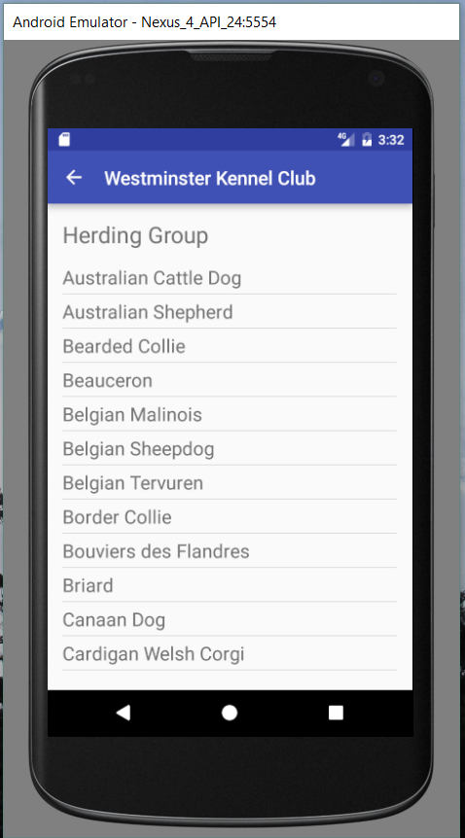
Screenshots
Notes:
...we see this
Note that I am setting the header TextView (Working Group, Herding Group...) dynamically using string resources. You did a similar task with your ActivityA, B, C practical.
Later we will see a more flexible way of doing this (the launching activity will pass the label text along).
The Herding group is so large that the ListView doesn’t fit on the screen. But the ListView scrolls, so we can scroll through, like this...

Slide 19
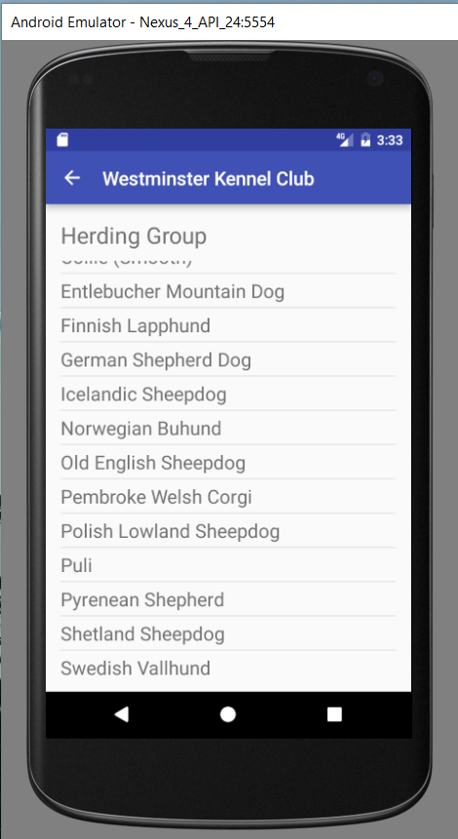
Screenshots

Slide 20
The Plan
Create the main Activity (the main Navigation screen)
Create each child Activity (one for each Breed Group)
Give the main a ListView
Wire up that ListView so that when clicked it launches one of the child Activities.
Notes:
Again, this is a brute force approach. Fine when you’re starting, but see if, as we are going through it, you can see opportunities for efficiency.
Questions about the wiring:
How will you launch a child Activity? => make an Intent
How will you know which Activity to Launch? => you will need to get the text of the clicked on item in the ListView. Luckily, the ListView has a method for this.
We know how to make Activities, so all we really need to do is figure out ListView.
Let’s look more closely at this control. We will see that everything we have learned about buttons and spinners and so forth is useful here...

Slide 21
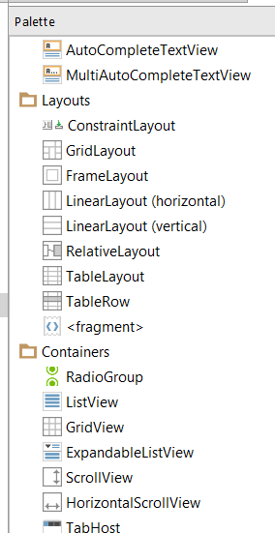
Using ListView
Populate it in the code behind
Wire up the item click event
Drag in from the Palette
Notes:
Three steps
The dragging in part is straightforward. Just scroll down a bit until you find the Containers.
Let’s look at the other two

Slide 22
Populating a ListView
Bind to a String[] using an Adapter
Notes:
We learned adapters earlier when we made a spinner. This is the same.
Let’s look at the code.
Where is this code, do you think? => in our main activity’s onCreate method.

Slide 23
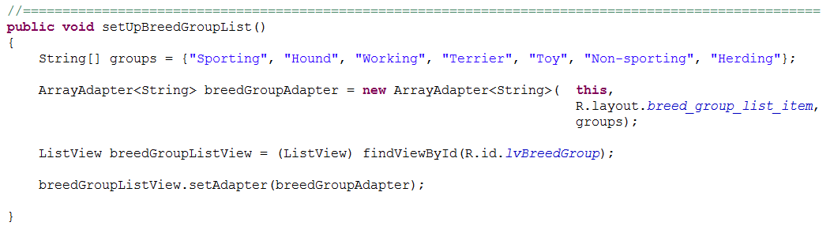
Populating a ListView
Notes:
Let’s get modular with this. We will call this method in the onCreate. Using methods like this will keep your onCreate from getting overwhelmed.
Exactly as you did with the spinner
Make an array.
Make an adapter. Pass in the context (the current activity), the layout for the textView (use android.R.layout.xxx if you wish, or you can make your own, as I did here – we’ll see it in a second.)
Grab the ListView
Bind it with setAdapter.
Run it and your awesome list will appear. It won’t do anything yet, because we haven’t wired it up. But that’s ok. We know how...

Slide 24
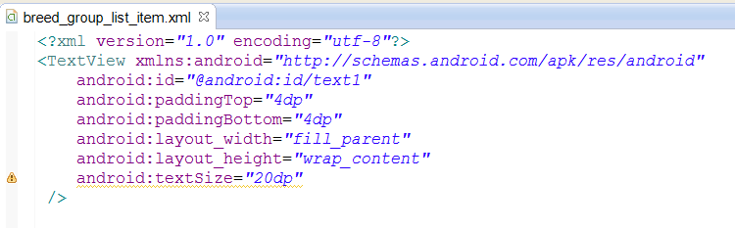
Optional Extension – Custom Layout
Notes:
The adapter just wants a TextView template.
Here’s mine. I wanted a little less padding and a larger text size than the android.R one had, so I made my own.
Create in /res/layout

Slide 25
Wiring Up a ListView for Clicking
Interface | OnItemClickListener
Method | onItemClick
Event Setter | setOnItemClickListener
Notes:
Here’s that pattern again...
Instead of onClick, we are working with onItemClick.
The only thing that is different is the arguments passed into that method and how to get the value of the clicked item.
We are going to first look at a simplified example where we don’t actually launch our activities, we just use Toast to say which thing we clicked on.
That way we can concentrate on these new bits.
Later, we will see the real handler with the intents.

Slide 26
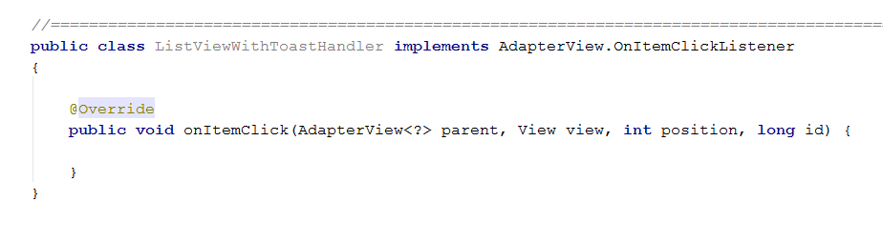
Defining the Inner Handler Class
Notes:
We implement the interface OnItemClickListener
It has just this one method onItemClick.
This is what you get if you let Android Studio “add unimplemented methods”
There are four arguments.
The AdapterView<?> thing is just a general syntax for members of the AdapterView class. ListView is one, and we can assume that parent is the actual listview who received the click.
But what are the others? ➔ We must consult the docs...

Slide 27
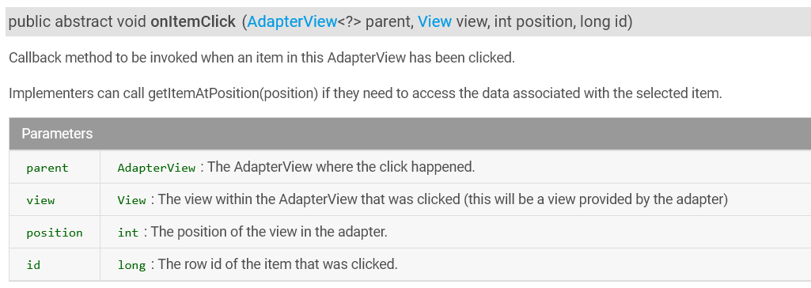
OnItemClickListener.onItemClick
Notes:
So View view is the list item that was clicked. Not just its text, but the whole control (think TextBox vs TextBox.Text).
Position is the index in the list of the clicked item (starting from 0)
id isn’t quite clear, but if you read around some more you will find that it is an additional id for the item that will remain the same if, for some reason the order of items in the list is changed (if, for example, you sort it).
Note the useful little tip about getItemAtPosition.
That’s the method we can use to find out the text that was clicked on.
Let’s look at the code of our Toast version...

Slide 28
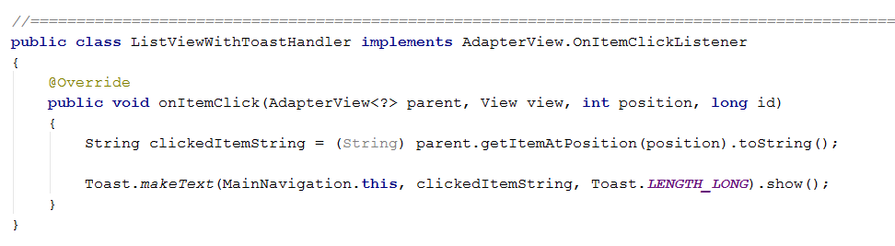
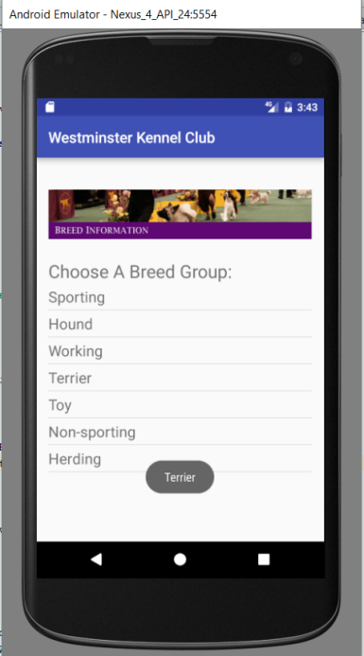
Defining the Inner Handler Class
Notes:
If we get this wired up to the button correctly, we will see...
And how to we wire it up? Just as always...with this code in where? => the onCreate.
Our two parts

Slide 29
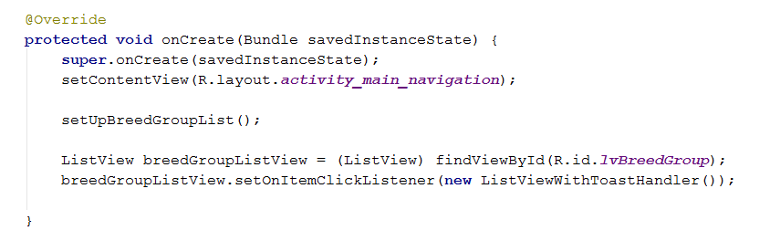
The Complete OnCreate
Notes:
Remember there were two parts: populate and wire up.
My complete onCreate for the Toast version looks like this...
We wrote the method setUpBreedGroupList – it used the Adapter
We wrote the inner class ListViewWithToastHandler
Here we use them both.
So now we know how to use ListViews. How will we use it for navigation in our Westminster app?

Slide 30
Building the Westminster App
Make 8 Activities: One for the main navigation (root) screen and one for each breed group (child) screen.
Put content on each breed group (child) Activity as appropriate.
On the main activity:
In the onCreate, populate a ListView with all the breed group names, using an Adapter
In the onCreate, write code in the OnItemClickListener class, to launch the children with Intent class objects.
Wire it up.
Notes:
In this simplest approach, just slap all the breed group members onto each child activity. There are too many breeds to fit on a single screen.
What control might you use? => ListView
Do you know how to populate it now? => Yes.
Which of these do we know how to do?
Making activities? => Yes. Although we will see one little useful trick...
Putting content on the children? => Yes. Use TextView or ListView
Setting up the main? => Yes. We just did it. The only new bit will be the intents.
Let’s walk through it anyway...

Slide 31
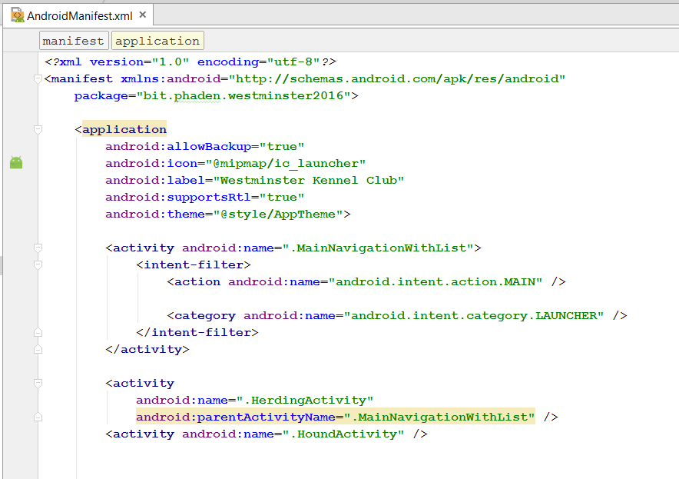
Creating Activities
Notes:
Just as before, with one extra little step.
Go into AndroidManifest.xml and add the parentActivityname attribute to your child Activities.
If you do this, you screens have magic up navigation.
Note the highlighting. The error message is that this only works in API16 and up (remember that Min SDK thing?).
So people running API 15 will have to use the hard back button, or you will need to provide alternative navigation.

Slide 32
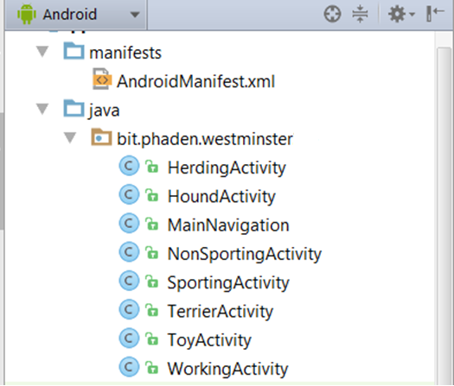
Creating Activities
Notes:
Here are mine in the package explorer...
Nothing wrong with having a lot of Activities at this point.

Slide 33
Populate the ListView
Notes:
We’ve seen this already, but we can look at it again...

Slide 34
OnItemClick
Plan:
Get the clicked item
Use it in a switch statement
Create the appropriate intent
Start the new activity
Notes:
Here’s the tricky bit.
Again, we know how to do all this.
Only comment, when you try to switch on a String, you may be asked to update your java version. Do so.
Let’s look at the code...

Slide 35
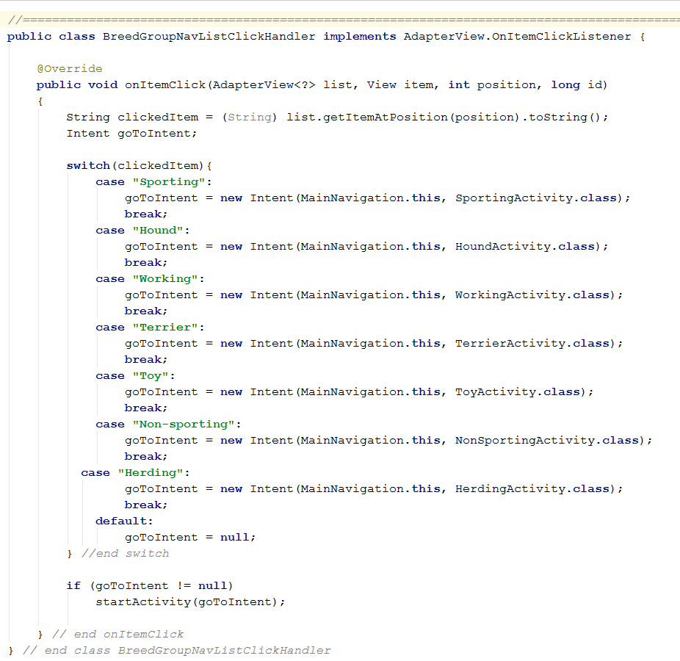
OnItemClick
Notes:
Again, this is brute force.
Can you think of a more efficient way?

Slide 36
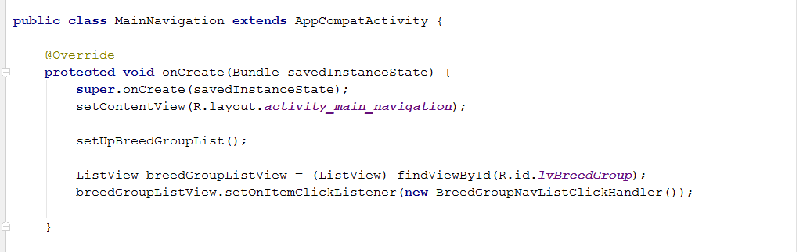
Wire It Up
Notes:
Again, we know how to do this

Slide 37
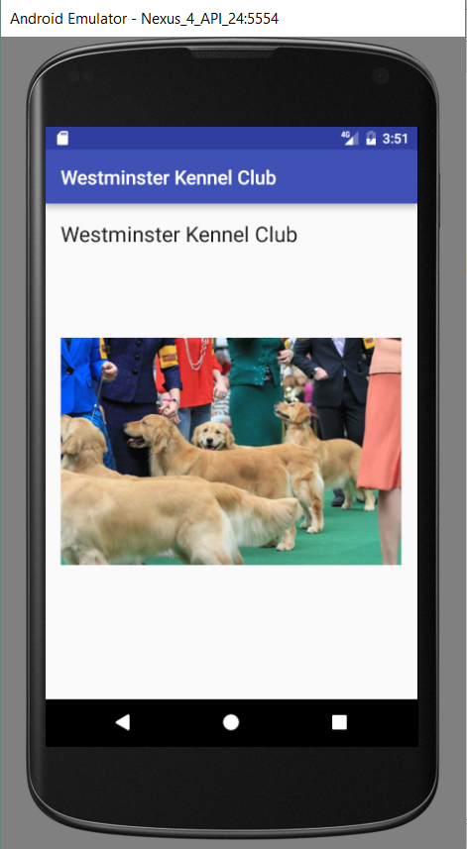
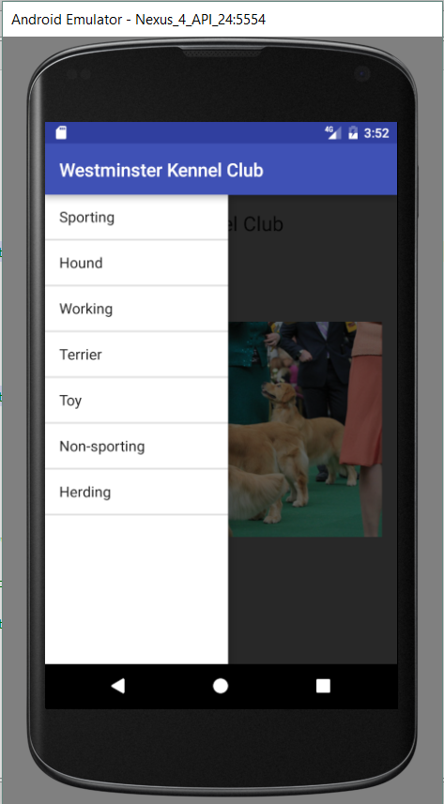
Navigation Option 2
Use a Navigation Drawer
Notes:
The navigation drawer basically takes your ListView from the previous example, and hides it off to the side.
The user swipes in to see it (in the emulator, get the mouse cursor well over to the left and drag right).
The advantage is that the full main screen is available to content, instead of having to be devoted to being a nav list.
It looks like this...
The only thing you have to change is the layout of the mainActivity.

Slide 38
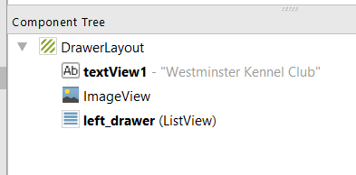
Main Layout
Notes:
Getting a nav drawer is easy.
We just need to change our outer container from a LinearLayout to a DrawerLayout, as shown here..
We keep the same ListView control (here its name is changed to left_drawer to make it clear how it works).
Simply by being contained in a drawer_layout (and configured correctly) it automatically becomes a slide-in.
The configuring part introduces a couple of technical issues. Let’s look at the layout xml file more closely...

Slide 39
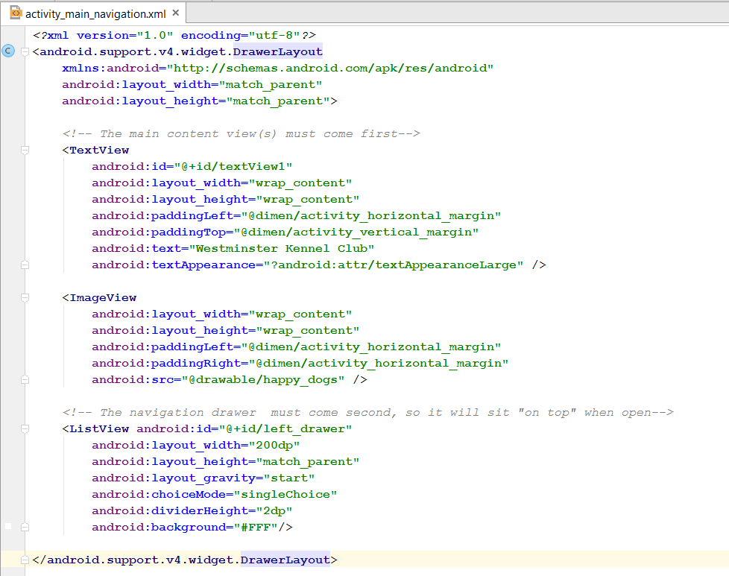
Layout with Navigation Drawer
Notes:
Note that the DrawerLayout is not in the main android library, it is in android.support.v4.widget
You will need to fully qualify the xml element like this.
You need to think of this layout as having two parts: the nav drawer (which is just the same ListView we used before) and the normal content that shows when the nav view is tucked away (in this example, that is the TextView and ImageView).
The normal content must come first, and the nav content (the ListView) must come second.
The controls in a layout have z-order (distance from the user) and the earlier in the layout, the lower the z-order. So the nav drawer control comes last, so it will sit on top.

Slide 40
DrawerLayout Library Error
“Error inflating class android.support.v4.widget.DrawerLayout”
http://envyandroid.com/archives/965/drawerlayout-inflation-exception
Notes:
When using these support libraries, you have to have your build path set just right. If it isn’t, you’ll get this error.
“Inflating” is the term Android uses for taking one of the those XML files and converting it into actual in-memory objects (ListViews and TextViews and so forth).
We will talk more about inflating next time.
For now, you just want to fix this error. It’s just a matter of clicking a couple of boxes in the properties. You can find details here.

Slide 41
Navigation Practical

